Slide 1
Breakthrough FAITH
Living a life of possible.

Slide 2
So do not throw away this confident trust in the Lord. Remember the great reward it brings you! 36 Patient endurance is what you need now, so that you will continue to do God’s will. Then you will receive all that he has promised.
37 “For in just a little while, the Coming One will come and not delay. 38 And my righteous ones will live by faith.[a]
But I will take no pleasure in anyone who turns away. But, we do not belong to those who shrink back and are destroyed, but to those who have faith and are saved. Hebrews 10:35-39

Slide 3
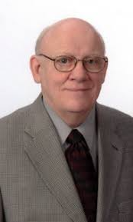
Faith is personal confidence in the character of God and in the reliability of His promises as we obey His will. Faith in the Lord will enable us to step out in obedience to God regardless of how we feel, or what the circumstances in our lives look like. Warren Wiersbe

Slide 4
I used to think that I should close my bible and pray for faith, but I came to see that it was in studying the Word that I was to get faith.
D L Moody.

Slide 5
So, we are Christ’s ambassadors; God is making his appeal through us. We speak for Christ when we plead, “Come back to God!” 2 Corinthians 5:20
For we are citizens of heaven where the Lord Jesus Christ lives. Philippians 3:20

Slide 6
Breakthrough FAITH
Living a life of possible.

Slide 7
Lord Jesus, thank you for dying for me, and forgiving me. Thank you for paying the price for my sins and making it possible for me to stand righteous before you. I am forgiven, I am clean, I am guilt free because of you Lord Jesus.
Thank you for filling me with Your Holy Spirit. Fill me today Holy Spirit. Fill me with your presence and power, enabling me to live out your purposes and plans for my life and give me faith to see Your Kingdom bring freedom, healing, and breakthrough in my life and through my life, so that all would know that Jesus Christ is alive.
Amen

